Slide 1
Measurement systems & Data acquisition
KON-C2004 Mechatronics Basics
12.11.2024 Raine Viitala & Panu Kiviluoma

Slide 2
Mechatronic machine - subsystems
Controlling
computer
User Interface
Sensors
Signal
processing
Communication
(Bus, IoT, 5G)
Actuators
Controller
Affect and sense the physical world
Other systems and machines

Slide 3
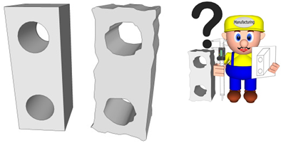
Philosophy of measurements
Measurement is always an estimate of the true value
Nobody can find out the true value
The real value exists only on the computer screen (CAD, signal analysing etc.)
In the real world all the objects, measured signals and physical magnitudes are erroneous

Slide 4
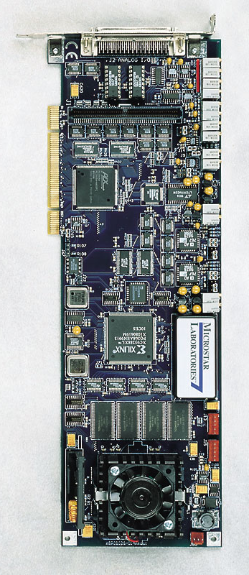
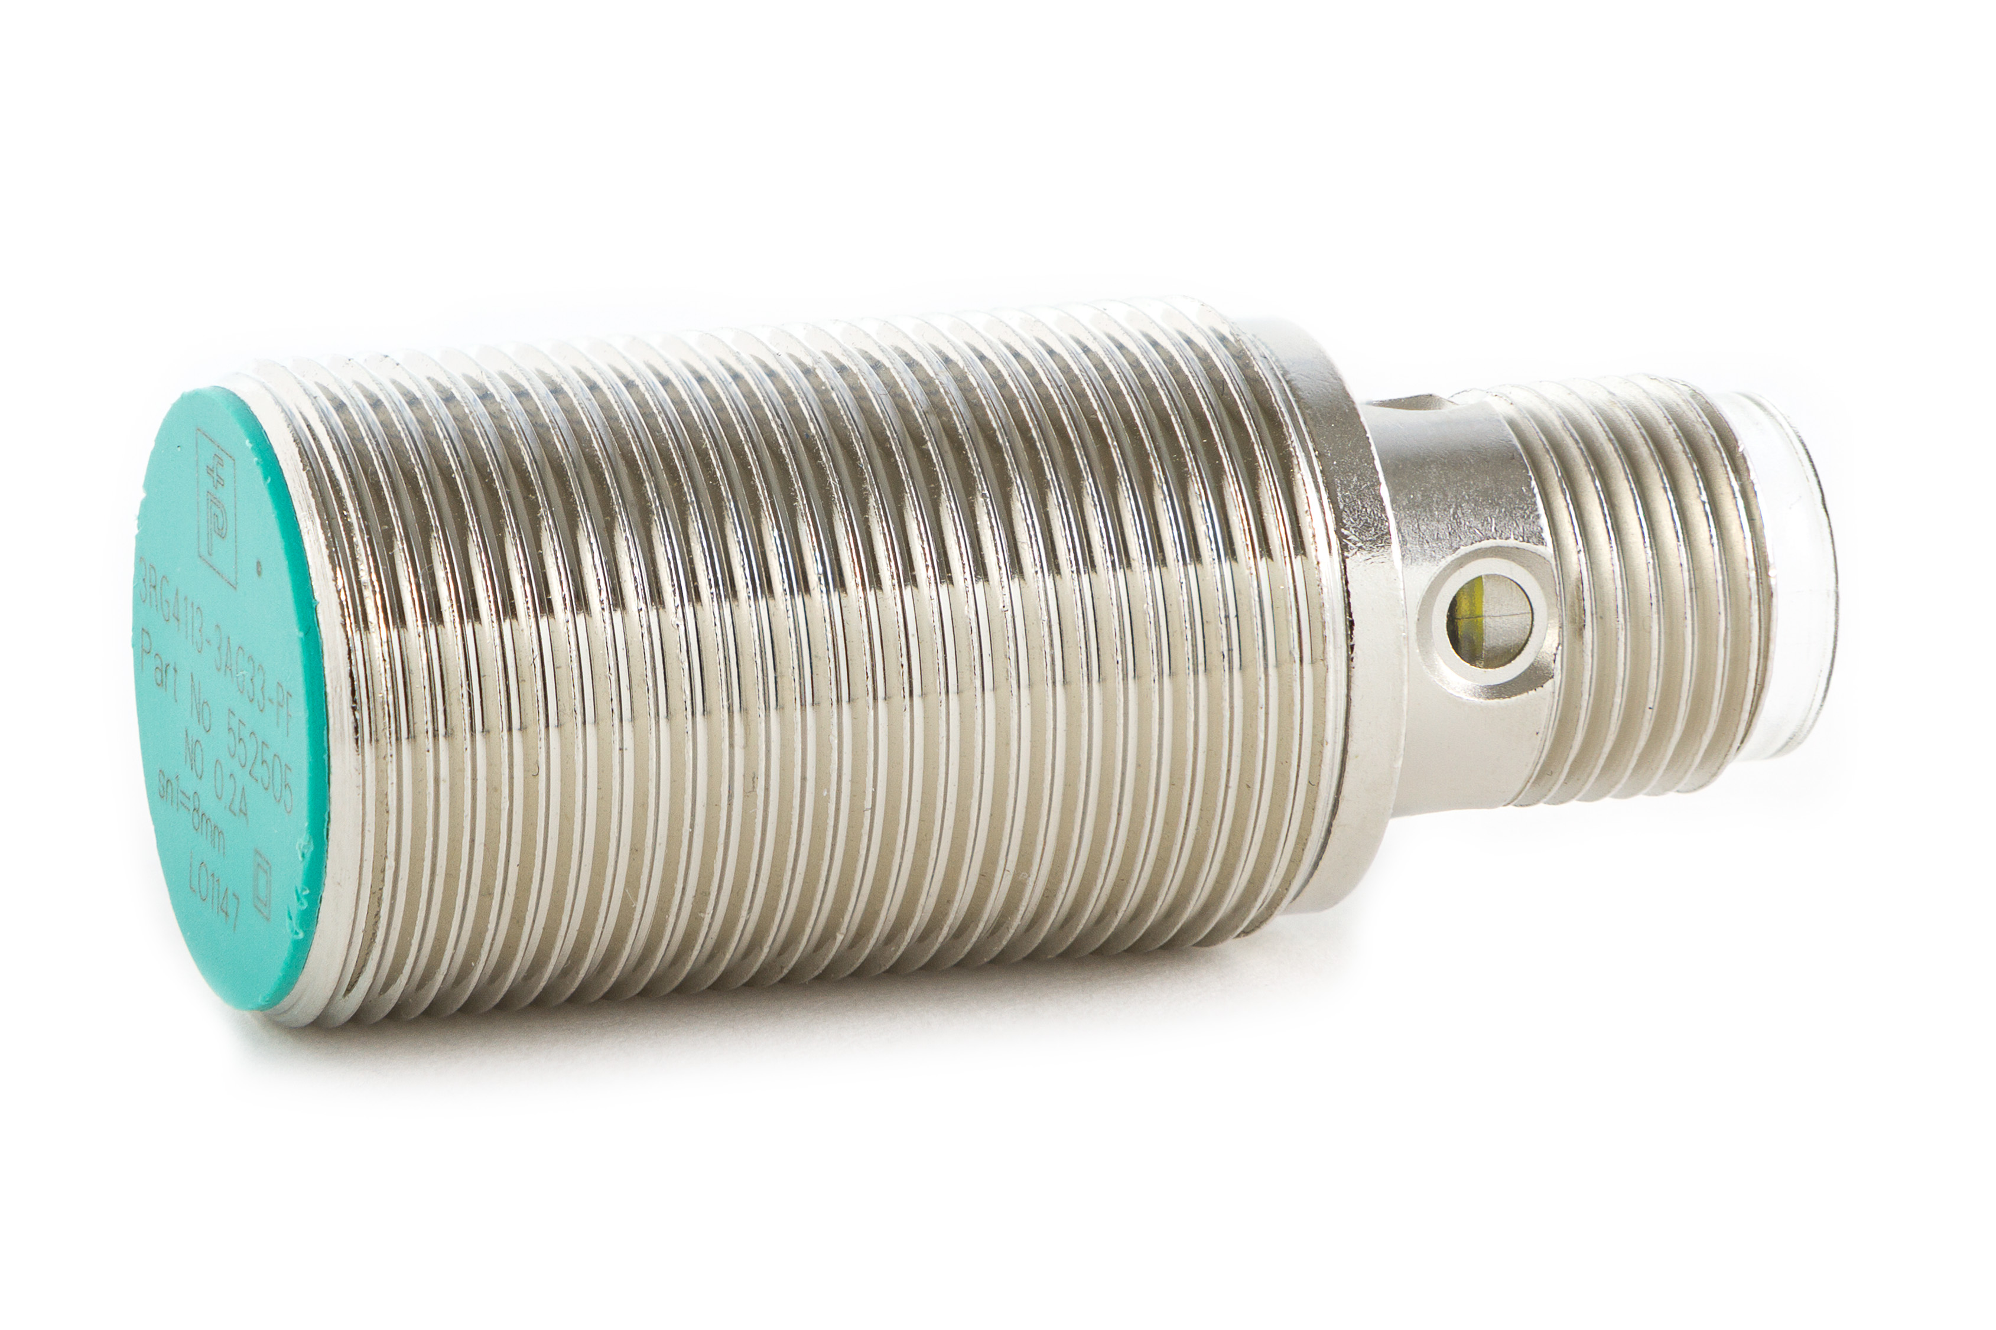
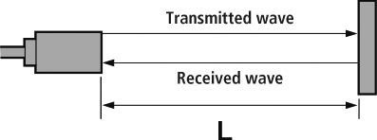
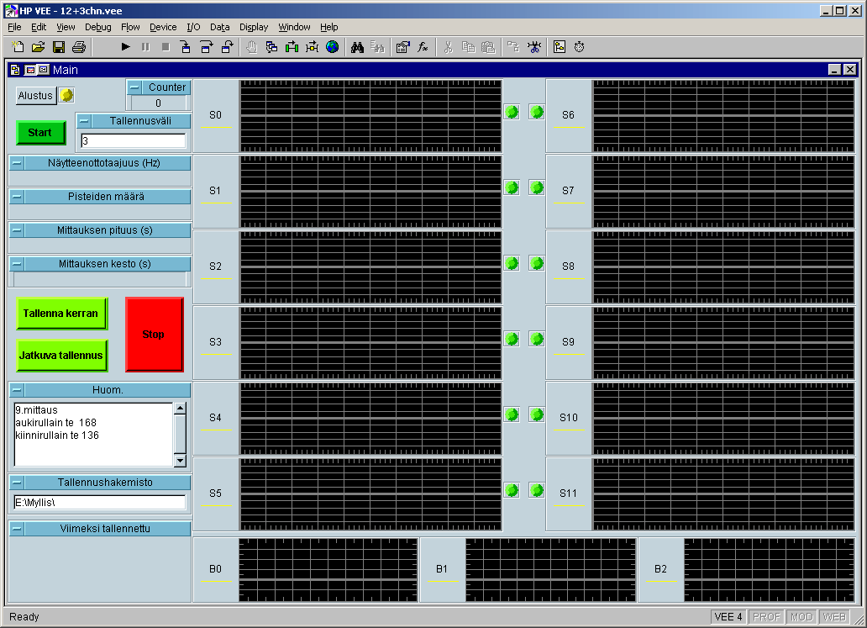
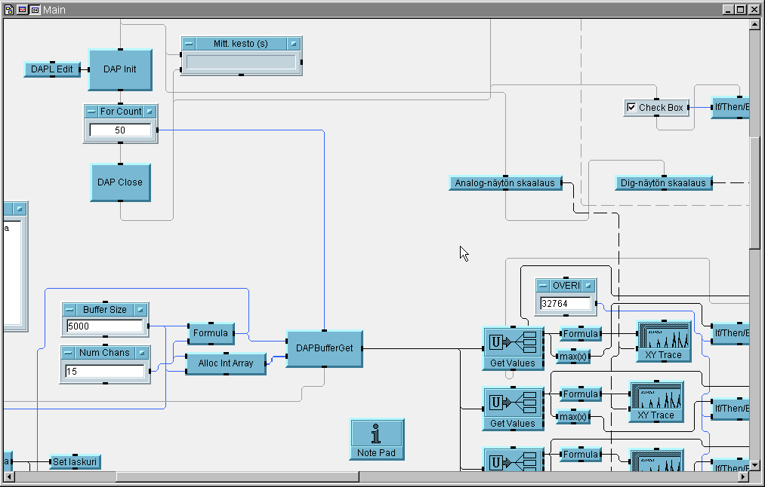
Architecture of a measurement system
Measurement Device
Software
Measurand
Sensor
Signal Conditioning
Driver
Analog-to-Digital Converter
Application
L
Voltage
Current
Charge
…
Texas instruments
Bosch PLC
Arduino etc.
Visual C++/Basic
Arduino
Labview
Matlab
…
National Instruments
Measurement Computing
Data Translation etc.
Conversion to another, typically electric physical quantity

Slide 5
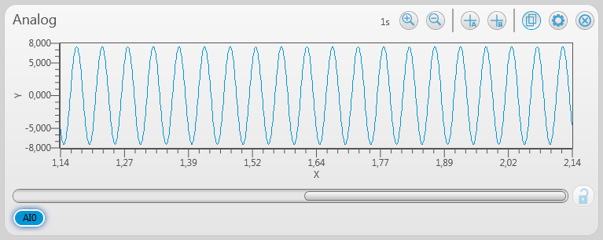
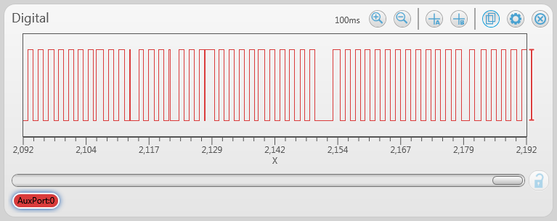
Signals Come in Two Forms: Digital and Analog

Slide 6
Signals
Analog
Voltage
Standard ranges
0…10V
0…5V
1…5V
-5…+5V
-10…+10V
Easy and cheap, susceptible to disturbance
Current
Standard ranges
0…20mA
4…20mA
Better immunity to disturbance
Digital
0 or 1
0 or 5 V
0 or 3.3 V
Easy to process further
The best immunity to disturbance
“Computer proof”

Slide 7
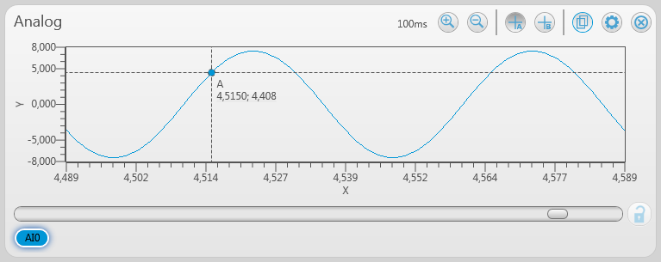
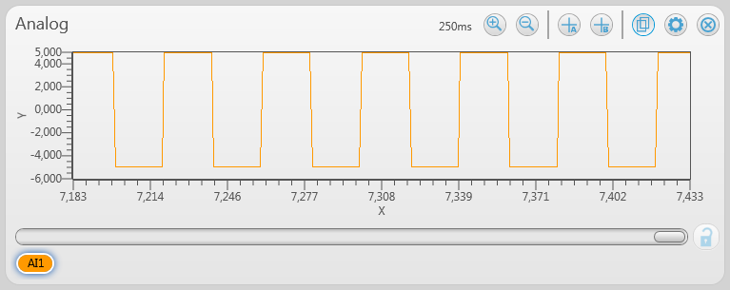
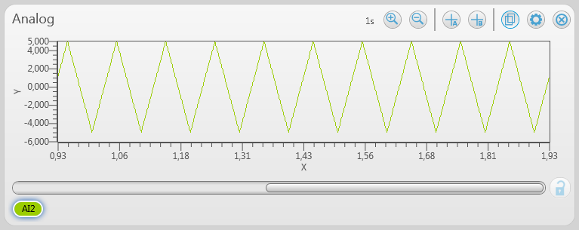
Analog Terminology
Level
The instantaneous value of the signal at a given point in time
Shape
The form that the analog signal takes, which often dictates further analysis that can be performed on the signal
Frequency
The number of occurrences of a repeating event over time

Slide 8
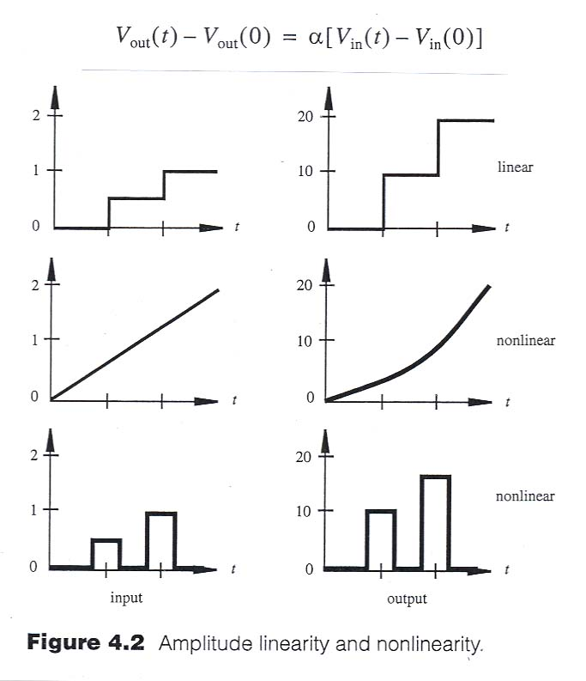
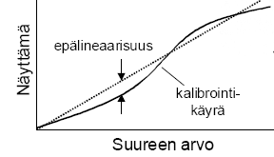
Linearity
reading
nonlinearity
Calibration
curve
quantity

Slide 9
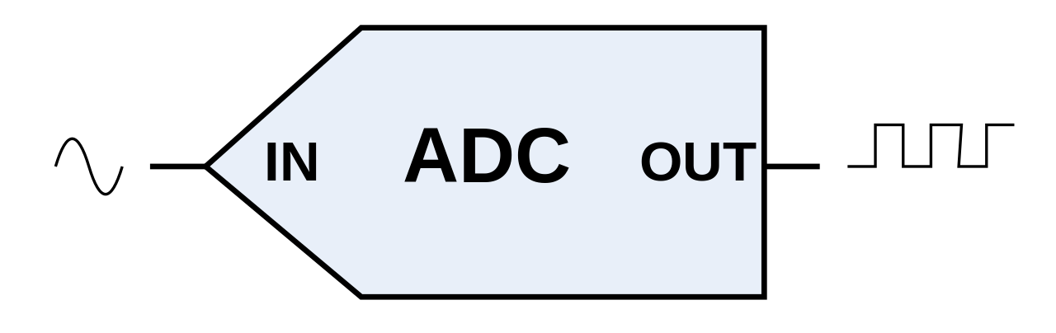
Analog to Digital
8bit → 2^8 = 256
16bit → 2^16 = 65536
22bit → 2^22 = 4194304
Selection criteria
Number of bits
Resolution, quantization noise
Sampling frequency
Dictates the highest measurable frequency
Input range
0…1V, ±5V, …
Number of channels
Multichannel
Sample and Hold / Multiplexer

Slide 10
Digitized signal
7
1Hz sine: 10S/sec, 3bit
AD conversion
6
Outputted “signal”
Time Value
0 4 (100)
0,1 6 (110)
0,2 7 (111)
0,3 7 (111)
0,4 6 (110)
0,5 4 (100)
0,6 2 (010)
0,7 0 (000)
0,8 0 (000)
0,9 1 (001)
1,0 3 (011)
…
3bit → 2³ = 8 values
5
4
3
2
1
Resolution?
0
0
0,1
0,2
0,3
0,4
0,5
0,6
0,7
0,8
0,9
1,0
Aika (s)

Slide 11
7
1Hz sine: 10S/sec, 3bit
Range?
6
3bit → 2³ = 8
5
4
3
2
1
0
0
0,1
0,2
0,3
0,4
0,5
0,6
0,7
0,8
0,9
1,0
Aika (s)

Slide 12
7
1Hz sine: 10S/sec, 3bit
6
3bit → 2³ = 8
5
4
3
2
1
0
0
0,1
0,2
0,3
0,4
0,5
0,6
0,7
0,8
0,9
1,0
Aika (s)

Slide 13
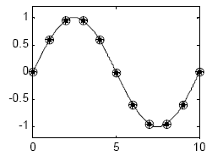
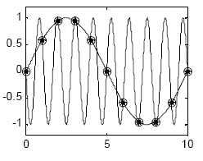
Sampling frequency
Sampling
Generated signal
!!??

Slide 14
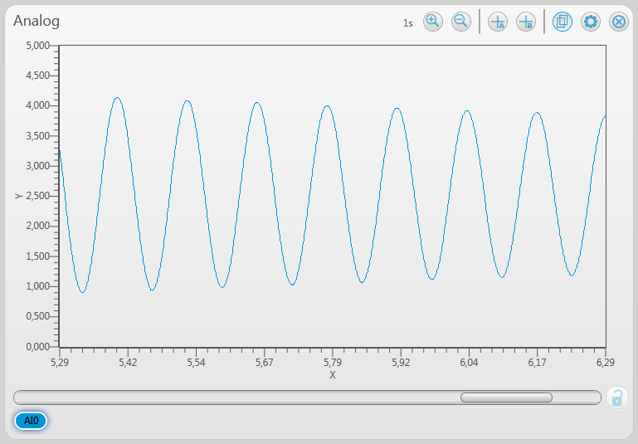
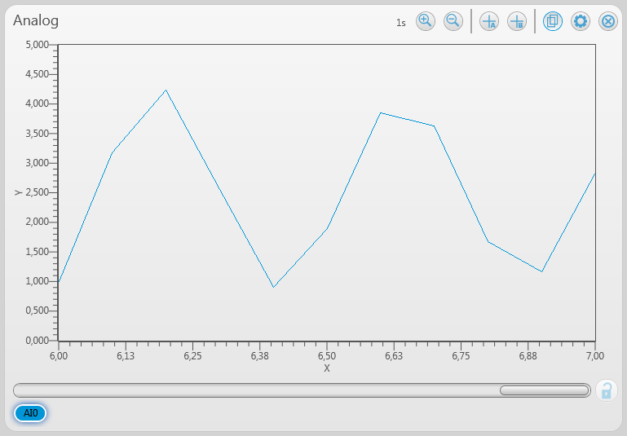
Effects of sampling rate vs. signal frequency
Aliased!
f_{s}=1000 Hz f_{s}=10 Hz

Slide 15
How to Prevent Aliasing Nyquist Theorem
Frequency
To accurately represent the frequency of your original signal…
You must sample at greater than 2 times the maximum frequency component of your signal
Shape
To accurately represent the shape of your original signal…
You must sample between 5–10 times greater than the maximum frequency component of your signal .

Slide 16
Common Signal Conditioning for Voltage Measurements

Slide 17
Conditioning Signals
Signal conditioning improves a signal that is difficult for your DAQ device to measure
Signal conditioning is not always required
Noisy, Low-Level Signal
Filtered, Amplified Signal

Slide 18
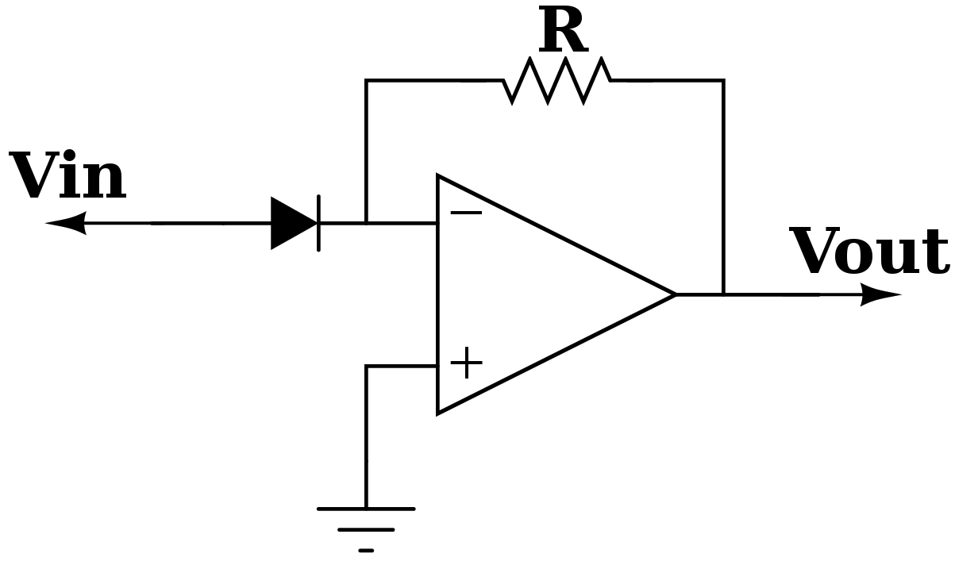
Amplification
Used on low-level signals
Maximizes use of analog-to-digital converter (ADC) range and increases accuracy
Increases signal-to-noise ratio (SNR)

Slide 19
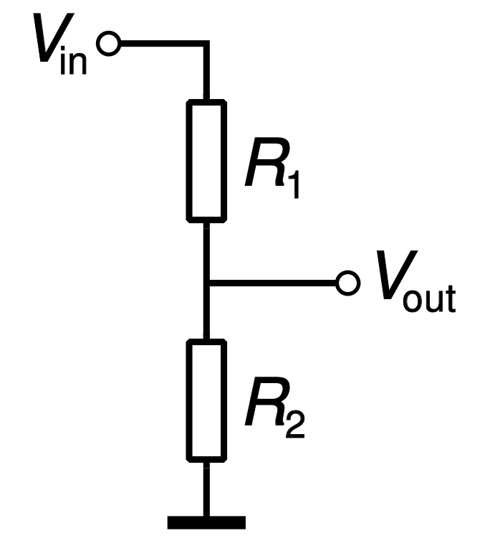
Attenuation
Decreases the input signal amplitude to fit within the range of the DAQ device
Necessary when input signal voltages are beyond the range of the DAQ device

Slide 20
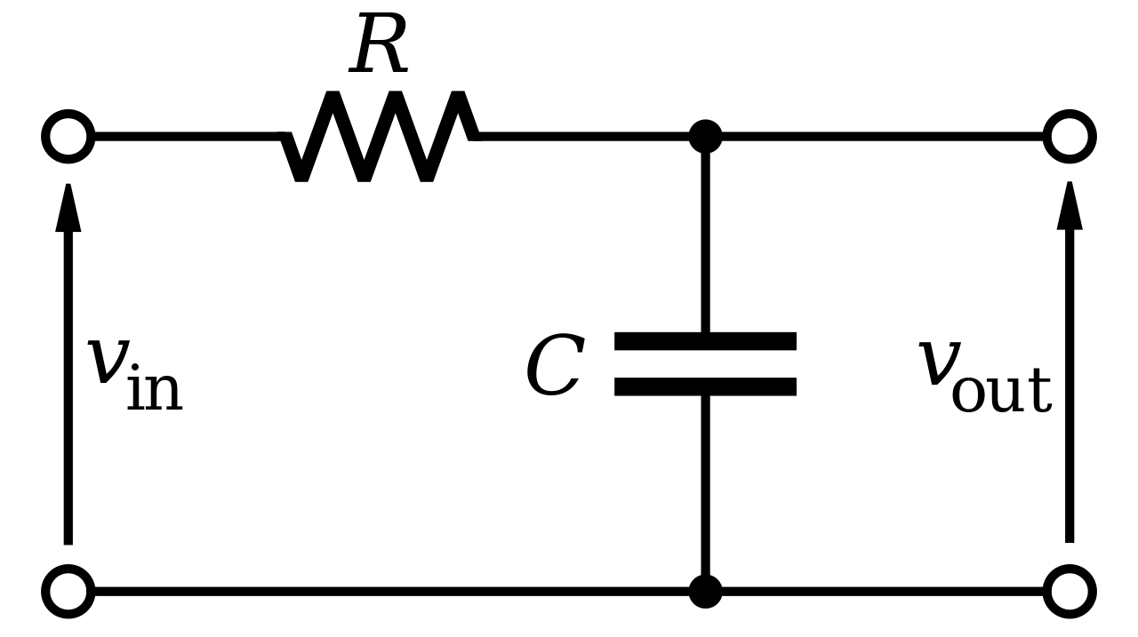
Filtering
Filters remove unwanted noise from a measured signal and block unwanted frequencies
Time
domain
Frequency
domain

Slide 21
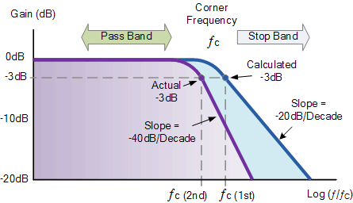
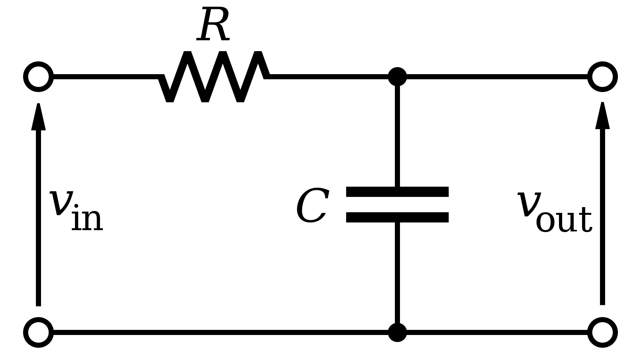
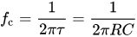
Low pass filter
Passband = low frequencies
Stopband = high frequencies
Cutoff frequency
Amplitude -3 dB i.e. gain ~0.7
Example: RC filter
1st order low pass filter
Simple to implement, not very effective
1 resistor, 1 capacitor
Cut off frequency:
Notes:
Low pass filter used to prevent aliasing and to reduce noice and disturbances above the desired frequency range. Also used for example in bass speakers.
Ideally constant gain of 1 from DC (0 Hz) to cutoff frequency.
Cutoff frequency is usually not a clear corner in the frequency response.

Slide 24
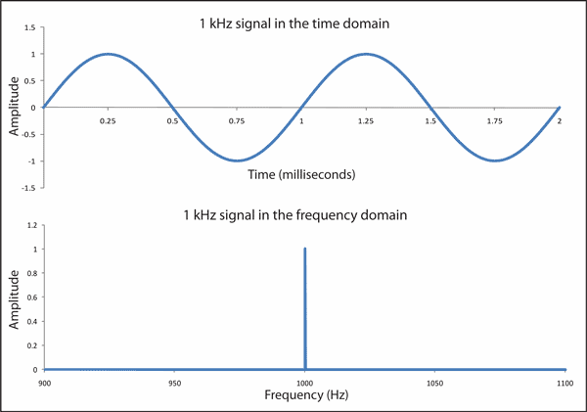
Fourier transform
Decomposing a signal into its sinusoidal frequency components
Signal in time domain
Signal in frequency domain
Notes:
Fourier transformation is a useful tool in signal processing.
Fourier transformation is a tranformation from time domain to frequency domain.
Fourier transformation can be used for filtering or compression. Filtering is easier to do in frequency domain than in time domain.
If the signal is not pure sine wave, it contains frequency components much higher than the main frequency. Thus for other than sine waves, the sampling rate must be much higher than the main frequency in order to record the shape of the curve.

Slide 25
Frequency domain analysis
Can be done easily using for example Matlab built-in function fft()
FFT = Fast Fourier Transform
Time domain
Frequency domain
Time domain
Frequency domain
SUM
+
+
Notes:
Vasemmalla aikatason jaksollisia aaltomuotoja, jotka ovat synkronissa telan pyörimisnopeuteen eli yhden kierroksen jaksonaikaan T
Vastaavat signaalit taajuustasossa
Edellisten signaalien summa aikatasossa
Summasignaali taajuustasossa
Käytännön signaalit edustavat summasignaalia kohinalla höystettynä, joten taajuusanalyysillä havaitaan, mistä komponenteista signaali muodostuu
Oheisessa kuvassa on käsitelty ainoastaan synkroniset taajuudet - taajuusanalyysin spektri kertoo kuitenkin kaikki merkittävät harmooniset taajuuskomponentit - myös asynkroniset

Slide 26
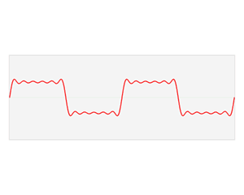
Fourier transform
Notes:
Higher frequency components not necessarily smaller as in the animation.
Fourier Matlab demo.

Slide 27
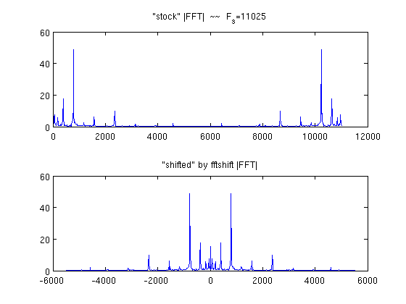
Discrete Fourier transform
Returns the amplitude of bands (or bins) of frequencies as complex numbers
0 Hz = DC offset
Magnitude = absolute value of complex number -> abs()
Phase = angle of the complex number -> angle() or atan2()
FFT – Fast Fourier transform algorithm
Matlab function fft(data)
Notes:
FFT – Fast Fourier Transform is probably the most used algorithm in digital signal processing. Calculates the discrete Fourier transform.
Real part of the fft result presents the amplitude of the sine waves, complex part represents the phase shift between the sine waves.
Results are mirrored for certain mathematical reasons. Initially first cell is 0 Hz for the left side, in the middle are highest frequencies and last cell 0 Hz for the right side.. Matlab function fftshift can be used to rearrange the graph sot that 0 Hz in the middle.
FFT result does not have a physical unit associated with it. The frequencies of the bins are evenly distributed and have to be scaled to represent the real frequencies.

Slide 28
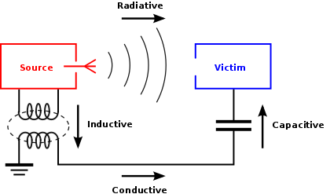
Electromagnetic interference can ruin your measurements
Eliminate ground loops
Wire condition and quality
Coaxial
Twisted pair
Shielding (Eg. CAT 6)
Isolation
Galvanic
Inductive
optical

Slide 29
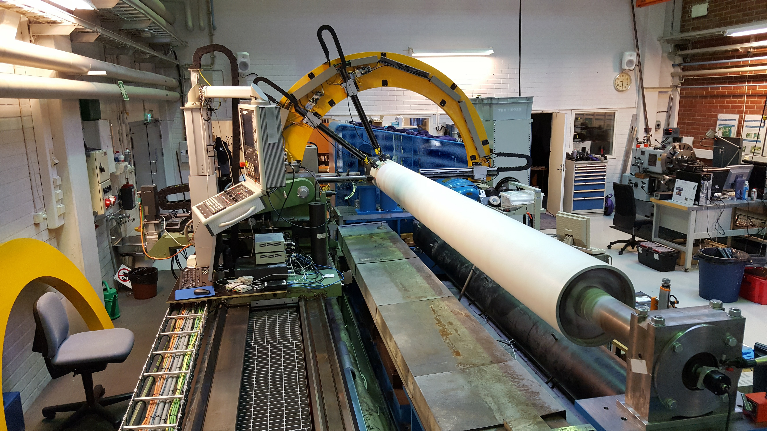
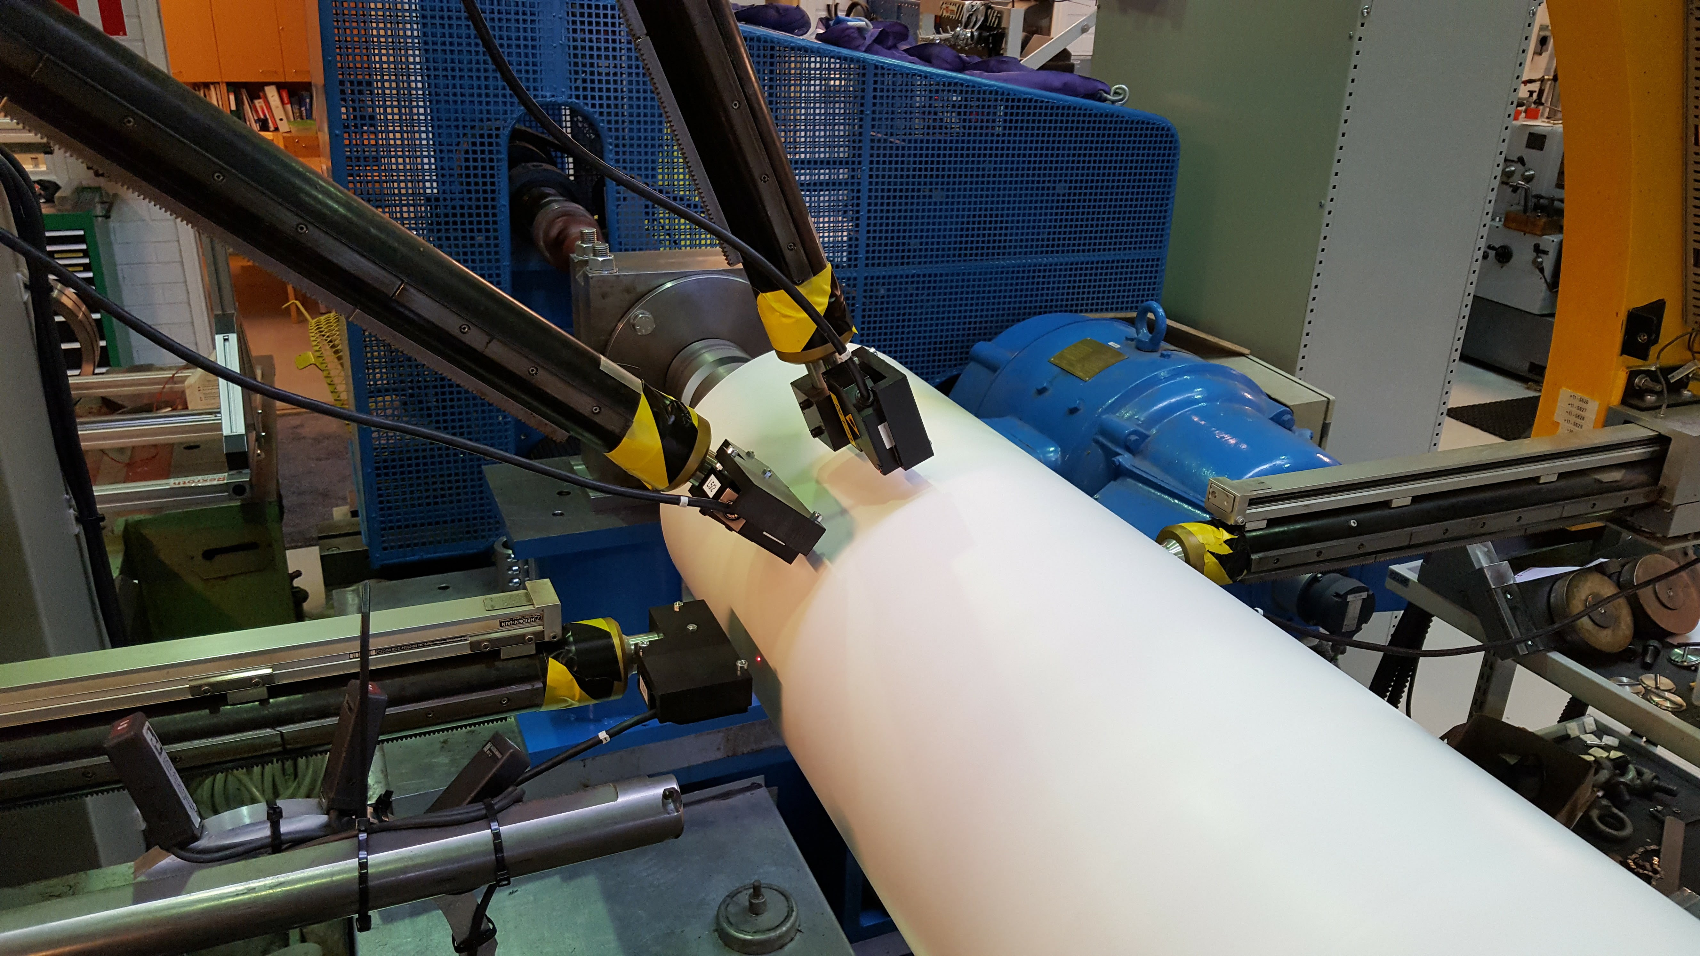
Case: paper machine roll run-out
Dynamic run-out
run-out as a function of the roll rotating frequency
Measurement objectives
Measure run-out of the roll
Measure angular velocity and angular position of the roll

Slide 30
Run-out
-roundness
-bearing error
-bending of the roll
Notes:
[6,59 3,26] [6,09 4,76][6,89 4,06 ][6,89 4,36][5,79 3,66][6,19 2,56][5,79 3,16][7,19 2,46][7,69 4,16][7,69 3,86][7,59 4,26][6,09 4,36]

Slide 31
Architecture of a measurement system
Measurand
Sensor
Measurement Device
Software
Signal Conditioning
Driver
Analog-to-Digital Converter
Application
L
Voltage
Current
Charge
…
National Instruments
Measurement Computing
Data Translation
…
Labview
DASYLab
Matlab
Visual C++/Basic
…
Conversion to another, typically electric physical quantity

Slide 32
Measurement setup
Sensors
Laser (displacement)
Filtering
LPF
Data acquisition
DAQ-card
Encoder (angle & speed)
Line receiver
Data processing and analysis
Labview
Matlab
PC
DAQ
LabView
ENC
4 x LASER
LPF
TTL
Matlab

Slide 33
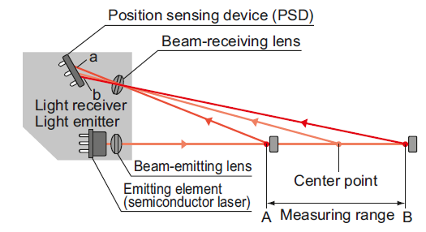
Sensors
Displacement (run-out)
Laser
Triangulation
Resolution 0.2μm
Sample rate 50kHz
Amplifier converts the distance to voltage: 1V ≡ 1mm

Slide 34
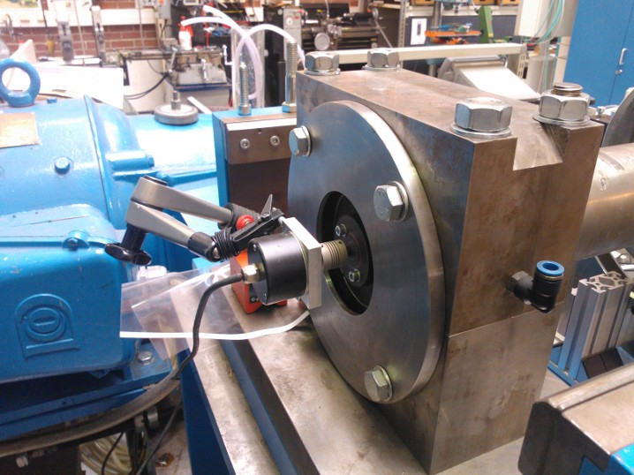
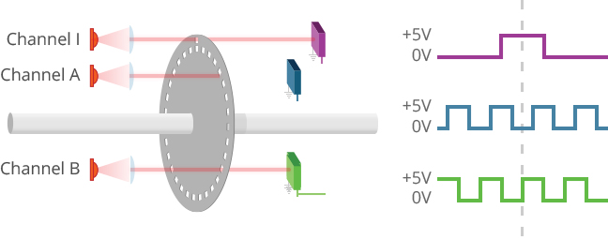
Sensors
Angle (position and velocity)
encoder
Roll angle at each disp. value
1024 pulses/rev
Resolution 0,35˚
Digital: 0V=0, 5V=1
2 channels + zero channel

Slide 35
Measurement setup
Sensors
Laser (displacement)
Filtering
LPF
Data acquisition
DAQ-card
Encoder (angle & speed)
Data processing and analysis
Labview
Matlab
Line receiver
PC
DAQ
LabView
ENC
4 x LASER
LPF
TTL
Matlab

Slide 36
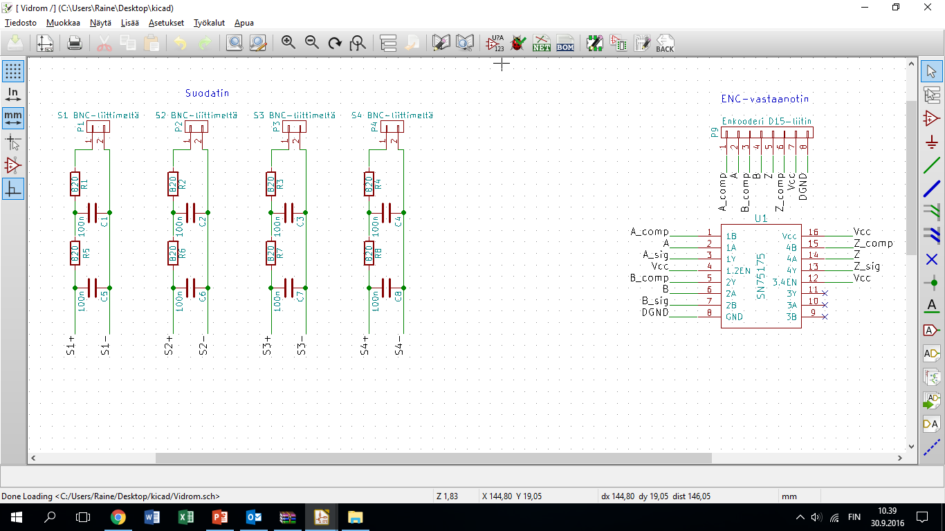
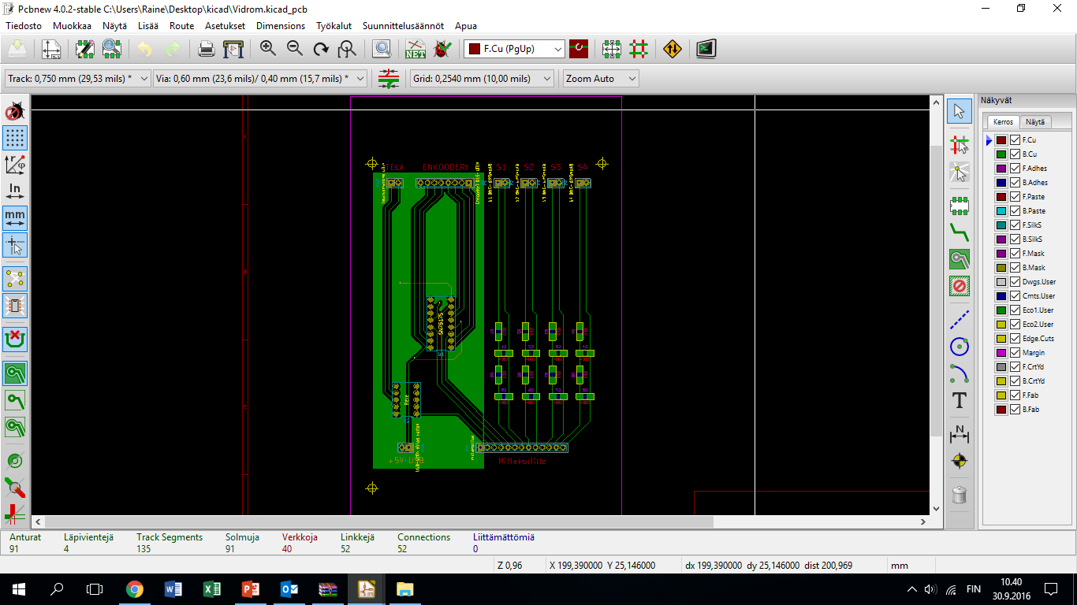
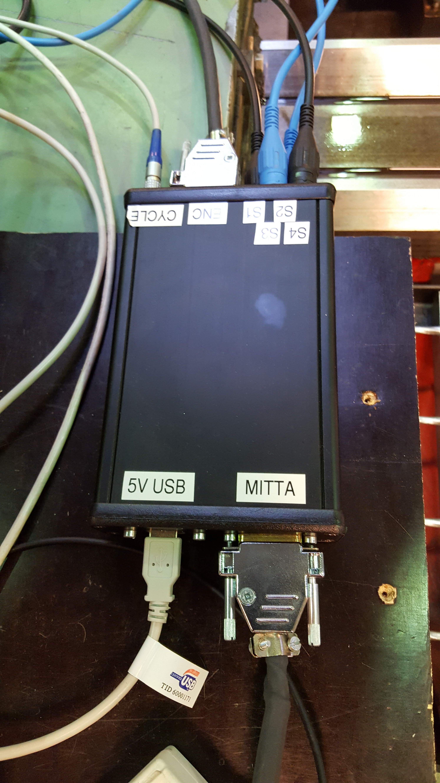
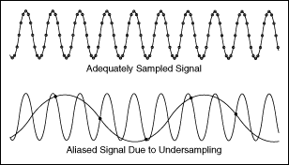
Aliasing
Nyqvist: min. sample rate = 2x lowest frequency of the system
High frequency disturbance corrupts the data
LPF: let only the interesting frequencies to the DAQ-card

Slide 37
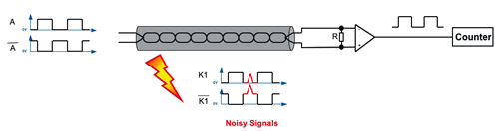
Differential digital signal trasmission
Electromagnetic coupling based disturbance
Variable frequency drive, electric motors, power supply units…
Differential signal transmission
TTL receiver (digital signals)

Slide 38
Measurement setup
Sensors
Laser (displacement)
Filtering
LPF
Data acquisition
DAQ-card
Encoder (angle & speed)
Data processing and analysis
Labview
Matlab
Line receiver
PC
DAQ
LabView
ENC
4 x LASER
LPF
TTL
Matlab

Slide 39
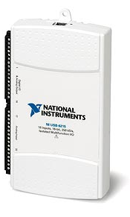
Data Acquisition
Measurement card – analog voltages and digital pulses are measured and converted to a computer-friendly format
NI USB-6215 USB
16 analog inputs (voltage, ±10V ), resolution 16 bit
2 analog outputs (voltage, ±10V), resolution 16 bit
4 digital inputs/outputs (0…5V)
Max. Sample rate 250 kHz
Multiplexer -> only one A/D-conversion unit ->converts voltages in turns from channel to channel

Slide 40
Measurement setup
Sensors
Laser (displacement)
Filtering
LPF
Data acquisition
DAQ-card
Encoder (angle & speed)
Data processing and analysis
Labview
Matlab
Line receiver
PC
DAQ
LabView
ENC
4 x LASER
LPF
TTL
Matlab

Slide 41
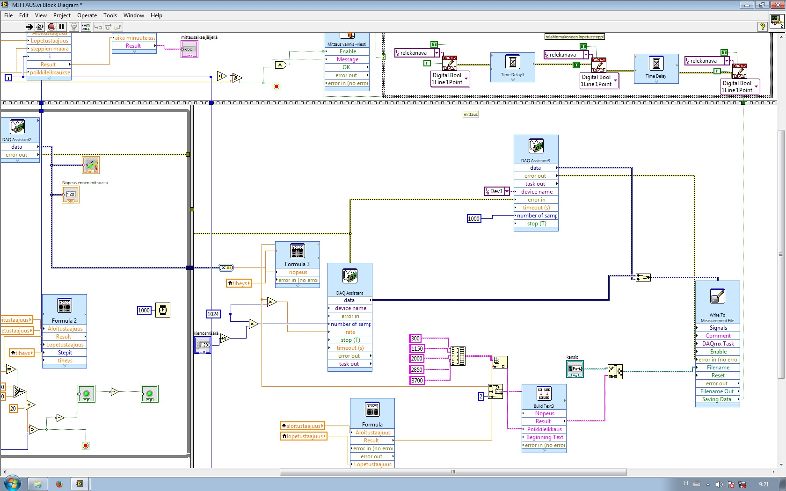
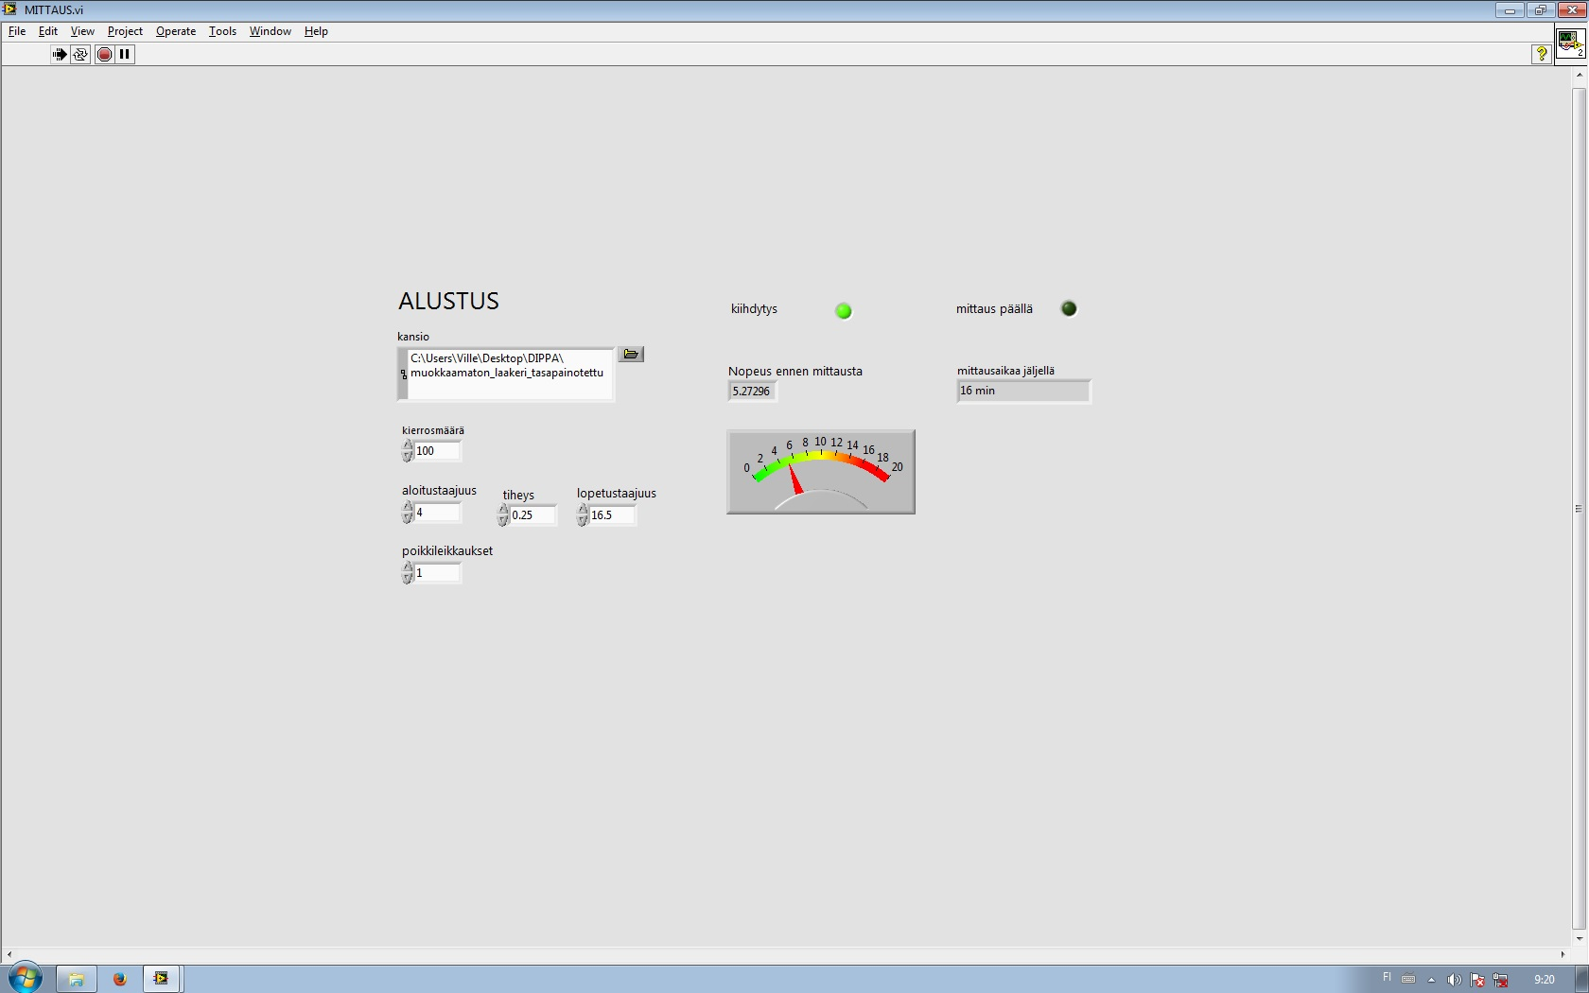
Measurement programming
Measurement task must be programmed to the DAQ-card
What is measured, which channel, how often…
Labview, Matlab, C++, arduino…

Slide 42
Measurement setup
Sensors
Laser (displacement)
Filtering
LPF
Data acquisition
DAQ-card
Encoder (angle & speed)
Data processing and analysis
Labview
Matlab
Line receiver
PC
DAQ
LabView
ENC
4 x LASER
LPF
TTL
Matlab

Slide 43
Analysis
From data to information
LabView, Matlab,…:
Data usually in text or binary forms
Data manipulation
Averaging
Frequency domain analysis (Fast Fourier Transform, FFT)
Charts and graphs

Slide 44
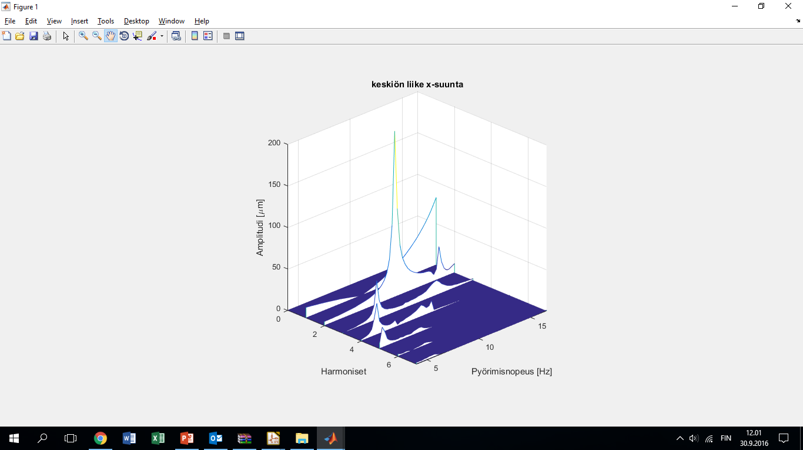
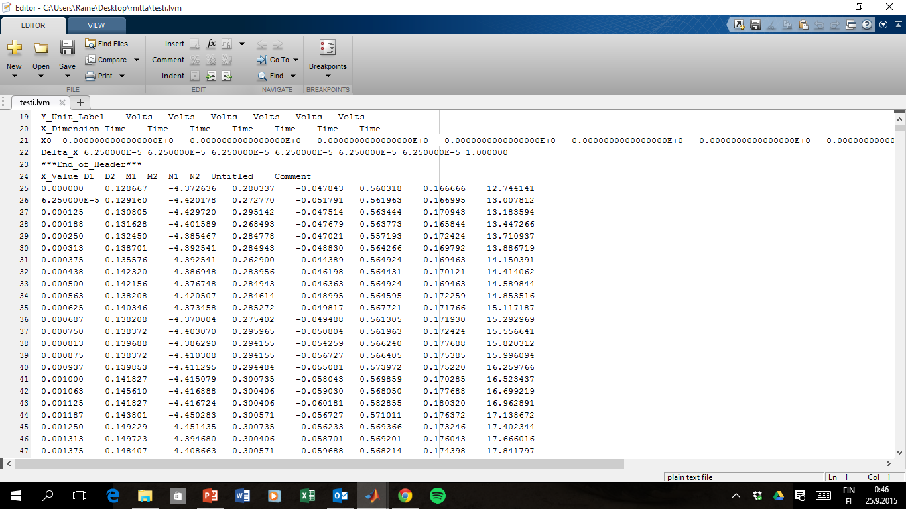
Analysis

Slide 45
Measurement uncertainty
True value not reachable
How to find out the error??? (measured – true value)
Not possible!
Measured values and Measurement uncertainty are both statistical variables: the result is within certain limits with certain probability
Systematic error -> calibration
For example constant error in a meter
Random error -> uncertainty
For example noise, vibration, stresses, temperature, measurer…
Harder to control!

Slide 46
Case: error sources – laser
Positioning error of the sensors (syst.)
Nonlinearity (syst.)
Noise and other EMC disturbance before DAQ
DAQ
ENC
4 X LASER
LPF
TTL

Slide 47
Case: error sources - encoder
Angular positioning error (syst.):
DAQ
ENC
4 X LASER
LPF
TTL

Slide 48
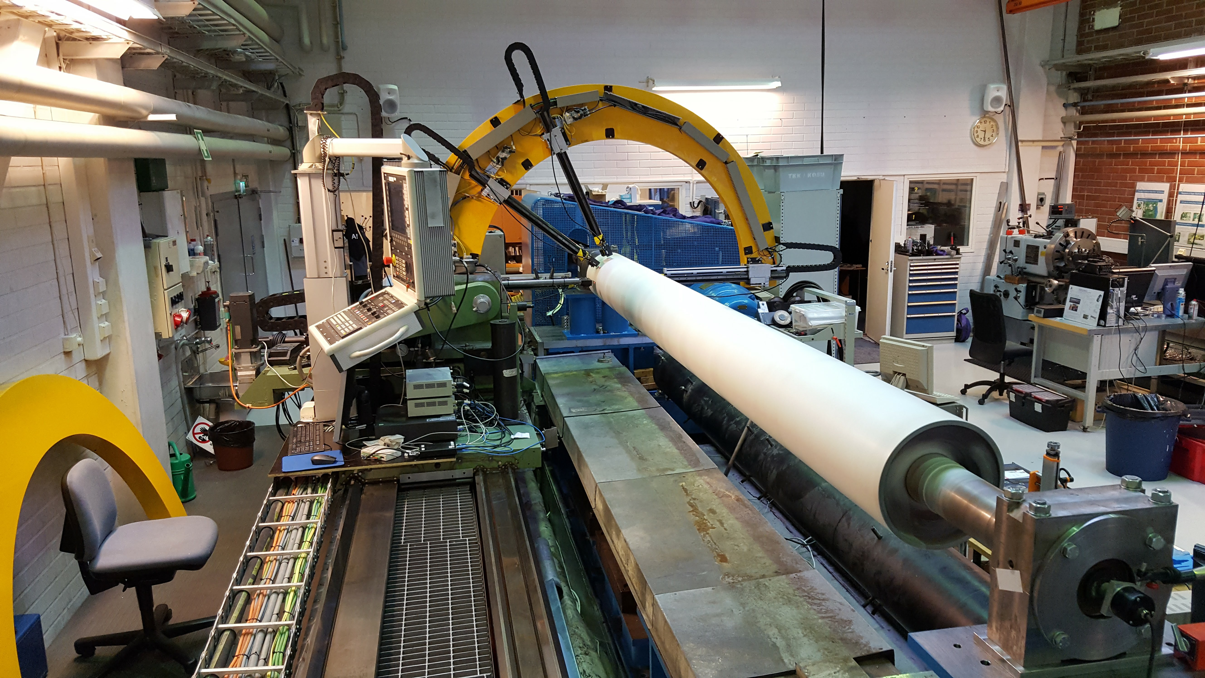
Case: error sources - measurer
Measurer causes easily systematic, random or coarse errors
Wrong
parameters
calibration
position
way of using a sensor
…

